Slide 1
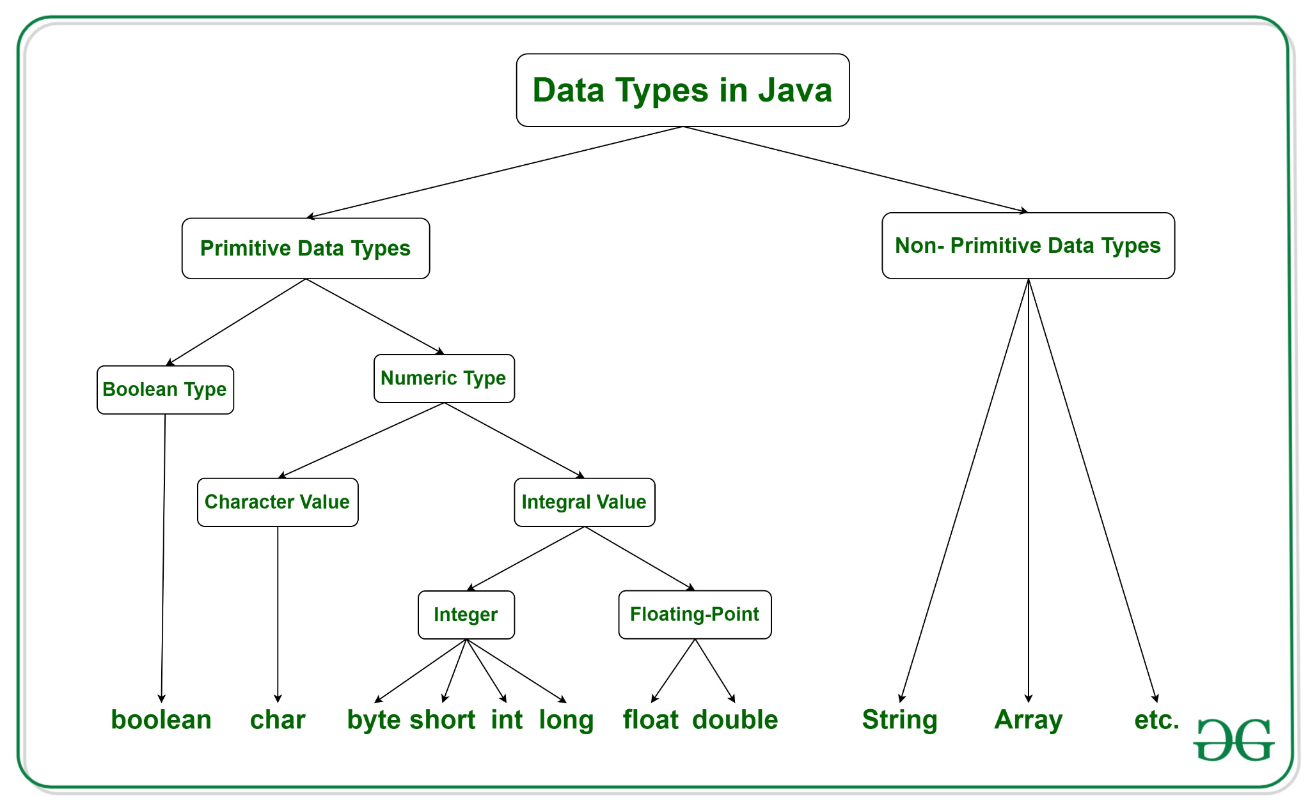
L04 Primitive Data Type Conversion and Casting

Slide 2
Today
Pick an Emojis that represents:
How you feel using Eclipse?
Check in
Questions on setting up Git/GitHub and Eclipse?
Who has Eclipse set up?
Meeting links | CS Office Hours | Microsoft Teams
Set up
Open Eclipse or Sit with someone that has Eclipse set up if you do not.
Go to your local repo and open documentation
Technical Documentation
Eclipse Cheatsheet
Go to canvas and open today’s participation to submit your tech doc
Goals:
Explain how data type selection affects memory allocation and potential overflow errors during program execution
Describe implicit and explicit conversion rules in assignment statements
Describe cast operator and apply in code
Explain mixed number (doubles and integers) operations
Deb is 🤩 Ready to help you
L🌻ve
L💗ve
La🤣gh
Le💡rn

Slide 3

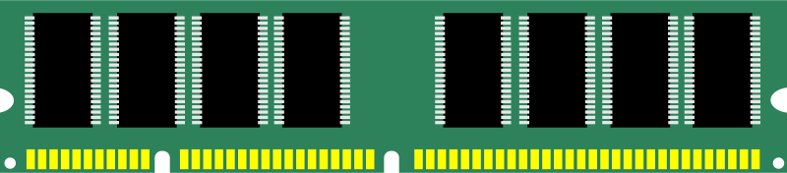
Memory Concepts
What happens when you declare a variable?
How do you read these statements with = ?
final double PI = 3.14
009AFD2A
How is the amount of memory to be allocated determined?
How is memory allocated for a constant different than a variable?
int radius = 4
009AFD30
How is the memory accessed?
double area = radius * radius * PI;
009AFD3C
Notes:
Will produce a double, store it in another memory location for doubles.

Slide 4
Memory Concepts
Memory is allocated to a location with a unique address to store that variable’s value.
The = means assign what is on the right and store in memory identified on the left
Declaring a constant (final) allocated enough memory for the data type in read only memory
final double PI = 3.14
009AFD2A
Declaring variables allocated enough memory for the data type in read/write memory
int radius = 4
009AFD30
Access the memory address through the identifier (variable or constant name ).
double area = radius * radius * PI;
009AFD3C

Slide 5
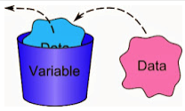
Cup Analogy
Each data type has a range of values that are valid for that type
Declaring a variable a certain type sets aside (allocates) a certain amount of memory for that variable
Think of a Variable as a Cup
Cup is a container -> Variable is a container
Cup holds something -> Variable holds a value
Cup has a size -> Variable has a size
Variable has a name (identifier)
Notes:
Think of a variable as a container.

Slide 6

Data Type Ranges and Literals
Data Type | Size | Minimum Value | Maximum Value
byte | 1 byte | –128 | 127
short | 2 bytes | –32,768 | 32,767
int | 4 bytes | –2,147,483,648 (-2^31) | 2,147,483,647 (2^31 – 1)
long | 8 bytes | –9,223,372,036,854,775,808 | 9,223,372,036,854,770,000
float | 4 bytes | ~1.4 × 10^–45 | ~3.4 × 10^38
double | 8 bytes | ~4.9 × 10^–324 | ~1.8 × 10^308
You assign a variable a certain data type which means it is a certain size
Then if you place a value into that variable that is too big it will "overflow"
This is like pouring the liquid of a big cup into a small cup - it "overflows"
Integer literals are assumed to be of type int. An integer literal can be assigned to an integer variable as long as it can fit into the variable.
int tooBig = 2147483648;
Error: Out of range would cause an overflow error.
Did you know this is a security issue?
What is an Integer Overflow Attack?
Notes:
When you declare a certain variable type, your data type determines how big.
Holds certain min and max for the value. If you go over what is allowed to be held, can cause security attacks.

Slide 7
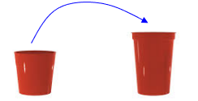
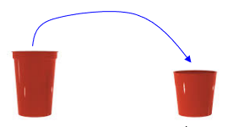
Code Discussion
Take turns describing each statement using terms: variables, identifier, naming conventions, declare, initialize, assign, memory and literals
int intValue1 = 123456;
int intValue2 = -9876543;
double doubleValue = 12345.23;
intValue1 = doubleValue;
doubleValue = intValue2;
Do you think there is any problem with these assignment statements?
int double
Double int
Notes:
Someone explain 1st 2 lines code, someone explain next 2 lines code, 3rd person do final lines of code.
5th line allowed, implicit casting, smaller can be put into a larger container.
Guess number code: takes double value makes an integer.

Slide 8
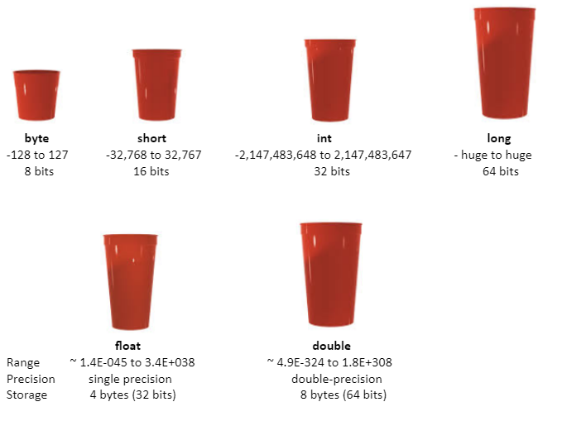
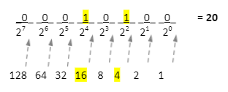
Primitive Data Types
Bits and bytes
1 byte is made up of 8 bits
This shows one byte whose value is 20

Slide 9
Rules
When declaring variables - be sure it’s potential values can fit into the type you assign (i.e. cup)
Pick the best type for your variable, although, if there are no concerns about memory
int – generally used as default type for integral values
double – generally used as default type for decimal values
You can put the contents of a smaller variable (cup) into a larger variable (cup)
int intValue1 = 123456;
int intValue2 = -9876543;
double doubleValue = 12345.23;
doubleValue = intValue2;
works!
int double

Slide 10
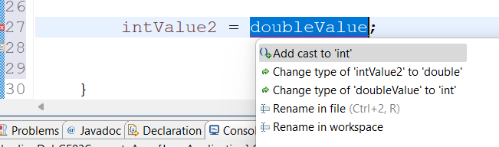
Error
You cannot put the contents from a larger variable (cup) into a smaller variable (cup)
Well you can but you must do something special to do so
You will also lose information when you do this
double int
int intValue1 = 123456;
int intValue2 = -9876543;
double doubleValue = 12345.23;
intValue1 = doubleValue;
Causes compiler error: cannot convert from int to double

Slide 11
Type Casting - Implicit (Widening)
Casting is an operation that converts one data type to another. Casting widens or narrows the type.
To convert a variable of one type into another type: (type)value
Widening: Casting a value with a smaller range to one with a bigger range
Java does this automatically because safe to do
Example double radius = 3;
implicit casting radius is stored as double 3.0 even though literal integer 3 is used.
Implicit casting of integer variable 42 into double when assigned to a double variable.
int smallNumber = 42;
double bigNumber = smallNumber; // int → double (implicit cast)
System.out.println("Original int: " + smallNumber);
System.out.println("After implicit casting to double: " + bigNumber);
Original int: 42
After implicit casting to double: 42.0
displays
Notes:
Implicit-smaller into larger, can just do

Slide 12
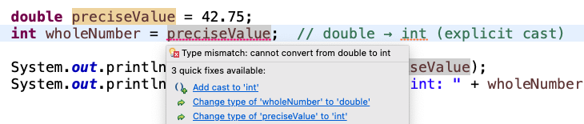
Type Casting - Explicit (Narrowing)
You cannot put the contents from a larger variable (cup) into a smaller variable (cup) unless you do something special - casting
Narrowing: Casting a value with a bigger range to one with a smaller range
To convert a variable of one type into another type explicitly: (type)value
You must do explicitly (manually) because it can result in losing data
Example int number = (int)3.1;
explicit casting is necessary
Explicit (manual) casting of double variable 42.75 using (int) preciseValue causes loss of data
double preciseValue = 42.75;
int wholeNumber = (int) preciseValue; // double → int (explicit cast)
System.out.println("Original double: " + preciseValue);
System.out.println("After explicit casting to int: " + wholeNumber);
Original double: 42.75
After explicit casting to int: 42
displays
Notes:
Explicit- cannot automatically do. Need to manually cast into a diff variable.

Slide 13
Explicit Casting Example
There are some problems where you will want to narrow from a larger variable (cup) into a smaller variable (cup).
For example if you want to generate a random integer
you can use the method random() to generate random double in the range [0.0, 1.0), meaning it includes 0.0 but not 1.0
Multiplying by RANDOM_MULTIPLIER (which is 100) gives a value in the range [0.0, 100.0)
Casting that to an int truncates the decimal part, resulting in an integer between 0 and 100.
final int RANDOM_MULTIPLIER = 100;
double randomResult= Math.random();
int number = (int) (randomResult * RANDOM_MULTIPLIER);
randomResult assigned 0.8736631218959736
number assigned 87
Notes:
Generates random double, int number

Slide 14
Numeric Type Conversion Examples
What is the difference between using the 3 literal and the 2.0 literal? What is the data type of each?
System.out.println("3 / 2 = " + (3 / 2));
System.out.println("3 / 2.0 = " + (3 / 2.0));
System.out.println("3.0 / 2 = " + (3.0 / 2));
System.out.println("3.0 / 2.0 = " + (3.0 / 2.0));
Output
3 / 2 = 1
3 / 2.0 = 1.5
3.0 / 2 = 1.5
3.0 / 2.0 = 1.5
What do you think is happening?
Notes:
The difference between using 3 and 2.0 is 3 is an integer, 2.0 is a double. Each has a different data type.
Saved as a specific data type depending on how you are declaring the value in an operator. Modulus and integer division.
When you have a mixed value, it results in the bigger cup size of a variable
Integer divided by double, result is a double so long as one value is a double.

Slide 15
Numeric Type Conversions
When performing operation involving two different types, Java automatically converts the smaller type is converted to a larger type before operation occurs but what is stored in memory doesn’t change.
For example if one of the operands is double, the others are converted into double.
int hours = 5;
double hourlyRate = 18.75;
double totalPay = hourlyRate * hours;
Memory allocated to store integer
Since hourlyRate is a double hours converted to double for calculation but remains integer in memory.
Notes:
Need to create new storage if you are combining different data types, need to store to larger data type typically.
Can copy and paste code from lecture examples and then play with it in tech doc.

Slide 16

Lab Exploration
Explore Interactive Animations
Compute Change
FahrenheitToCelsius
Discuss
Take turns finding different examples from the animations to explain
1. Explain implicit and explicit casting.
2. Explain numeric type conversion and
3. Explain integer division and modulus division.
You can use these examples to update your technical documentation.

Slide 17
Lab Pair Programming: Calculate Average
Discuss the parts of the code using the terms you have learned.
Calculate what the average should be
Predict what the computer will print out.
Put the code into Visualize Code and select java from the drop down.
Review lecture and discuss how you might fix this. Try out your ideas where one person drives and one person navigates.
Use an AI tool to help you understand what is wrong and possible solutions if you still can’t fix it.
Remember AI could use something you don’t understand or that is not the way we are doing it so always use lecture.
public class AverageScores
{
public static void main(String[] args)
{
int score1 = 80;
int score2 = 97;
int score3 = 85;
int total = score1 + score2 + score3;
double average = total / 3;
System.out.println("Total: " + total);
System.out.println("Average " + average);
}//end of main
}//end of class

Slide 18
Next
Remember commit and push
Other Resource: 1. Getting Started and Primitive Types — CS Java sections 1.6
No class Monday
See the preparation in today’s lecture
What should you be working on?
Do you have your environment set up? Are you practicing?
What can you attend to become better at using git, github and Eclipse?
When is it due?
Module 1 Quiz Sep 10th/ 11th - I will go over the quiz and preparing for it next week.

